Slide 1
Comparing Linear Functions in Different Forms
Algebra I | Module 2 | Topic 2 | Lesson 4
Notes:
Note: Total suggested pacing for this lesson is two 45-minute sessions.

Slide 2
Objectives
Compare linear functions represented algebraically, graphically, in tables, or with verbal descriptions.
Choose and interpret appropriate units to represent independent and dependent quantities in situations modeled by linear functions.
Choose and interpret appropriate scales and origins for graphs of linear functions.
Notes:
TEKS:
A.1A: apply mathematics to problems arising in everyday life, society, and the workplace.
A.1B: use a problem-solving model that incorporates analyzing given information, formulating a plan or strategy, determining a solution, justifying the solution, and evaluating the problem-solving process and the reasonableness of the solution.
A.1D: communicate mathematical ideas, reasoning, and their implications using multiple representations, including symbols, diagrams, graphs, and language as appropriate.
A.3A: determine the slope of a line given a table of values, a graph, two points on the line, and an equation written in various forms, including y = mx + b, Ax + By = C, and y − $y_{1}$ = m(x − $x_{1}$).
A.3C: graph linear functions on the coordinate plane and identify key features, including x-intercept, y-intercept, zeros, and slope, in mathematical and real-world problems.
A.12B: evaluate functions, expressed in function notation, given one or more elements in their domains.
ELPS:
1.D: speak using learning strategies such as requesting assistance, employing non-verbal cues, and using synonyms and circumlocution (conveying ideas by defining or describing when exact English words are not known).
2.G: understand the general meaning, main points, and important details of spoken language ranging from situations in which topics, language, and contexts are familiar to unfamiliar.
4.A: learn relationships between sounds and letters of the English language and decode (sound out) words using a combination of skills such as recognizing sound-letter relationships and identifying cognates, affixes, roots and base words.

Slide 3
Essential Question (1 of 2)
You have represented linear functions in a variety of different ways.
How does each linear function representation compare with
the others?
Notes:
Setting the Stage:
Tap into your student’s prior learning by reading the narrative statement.
Provide a sense of direction by reading the Essential Question.

Slide 4
Day 1
1
Notes:
Note: Total suggested pacing for Day 1 is 45 minutes.

Slide 5
Getting Started
5–10
Notes:
Note: Total time of 5-10 minutes allotted for the Getting Started.

Slide 6
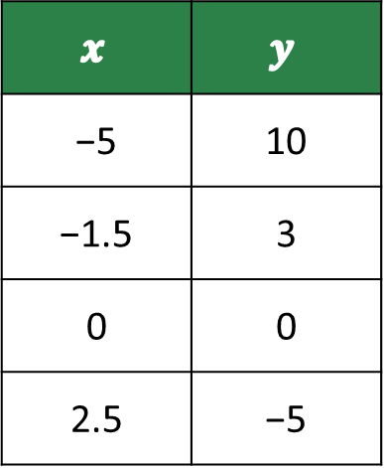
Odd One Out (1 of 4)
Choose the function that does not belong with the others and justify your choice.
Function A
Function B
$$x$$ | $$y$$
−5 | 10
−1.5 | 3
0 | 0
2.5 | −5
During one year at a high school, the ratio of 9th-graders to 10th-graders was 1 : 1.
Notes:
Questions to Support Discourse – Probing:
Is there more than one correct answer? Explain.
What would a graph of this function look like?
How do the slopes of the functions compare?
Compare the y-intercepts of the functions.
What is different about the functions’ domains?

Slide 7
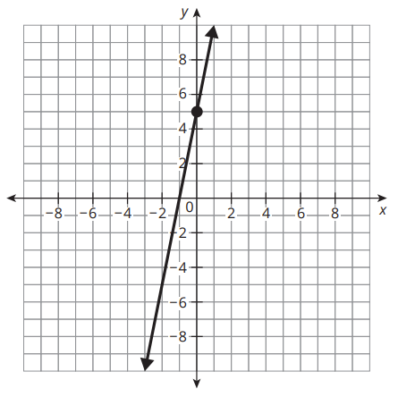
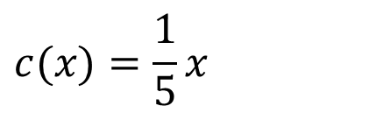
Odd One Out (2 of 4)
Function C
Function D
$$c(x)=\frac{1}{5}x$$
Notes:
Questions to Support Discourse – Probing:
Is there more than one correct answer? Explain.
What would a graph of this function look like?
How do the slopes of the functions compare?
Compare the y-intercepts of the functions.
What is different about the functions’ domains?

Slide 8

Odd One Out (3 of 4)
Let’s summarize our learning from the Getting Started!
Notes:
Getting Started Summary:
Characteristics of functions can be determined using a variety of different function representations.

Slide 9
Odd One Out (4 of 4)
Notes:
Note: This slide is blank for optional use with displaying work.

Slide 10
Activity 4.1
4.1
15–20
Notes:
Note: Total time of 15-20 minutes allotted for Activity 4.1.

Slide 11
Slopes of Linear Relationships (1 of 5)
Consider the line that represents the equation y = 4x − 3.
Determine whether the graph of each linear relationship is parallel, perpendicular, or neither parallel nor perpendicular to the graph of y = 4x − 3.
a.
b. An elevator descends 4 feet
every second.
x | y
−2.5 | −6
0 | 4
0.5 | 6
3 | 16
Notes:
Questions to Support Discourse – Gathering:
How can you use the slopes of two lines to determine whether the graphs will be parallel or perpendicular?
Questions to Support Discourse – Probing:
Do you need to calculate the slope between each pair of points in the table? Explain your reasoning.
What sign did you use for the slope of the elevator? Why?

Slide 12
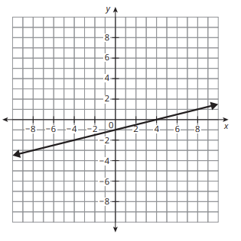
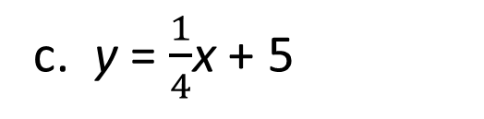
Slopes of Linear Relationships (2 of 5)
c. y = $\frac{1}{4}$x + 5
d.
Notes:
Questions to Support Discourse – Gathering:
How can you use the slopes of two lines to determine whether the graphs will be parallel or perpendicular?
Questions to Support Discourse – Probing:
Do you need to calculate the slope between each pair of points in the table? Explain your reasoning.
What sign did you use for the slope of the elevator? Why?

Slide 13
Slopes of Linear Relationships (3 of 5)
e.
f. For every hour Chiletso bakes, she makes 4 dozen cookies.
x | y
−4 | 3
0 | 2
2 | 1.5
8 | 0
Notes:
Questions to Support Discourse – Gathering:
How can you use the slopes of two lines to determine whether the graphs will be parallel or perpendicular?
Questions to Support Discourse – Probing:
Do you need to calculate the slope between each pair of points in the table? Explain your reasoning.
What sign did you use for the slope of the elevator? Why?

Slide 14
Slopes of Linear Relationships (4 of 5)
Let’s summarize our learning from Activity 4.1!
Notes:
Activity 4.1 Summary:
The slopes of different representations of lines can be compared to determine whether the graphs of their lines are parallel or perpendicular.

Slide 15
Slopes of Linear Relationships (5 of 5)
Notes:
Note: This slide is blank for optional use with displaying work.

Slide 16
Activity 4.2
4.2
10–15
Notes:
Note: Total time of 10-15 minutes allotted for Activity 4.2.

Slide 17
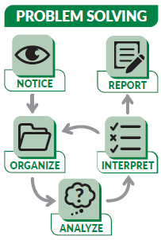
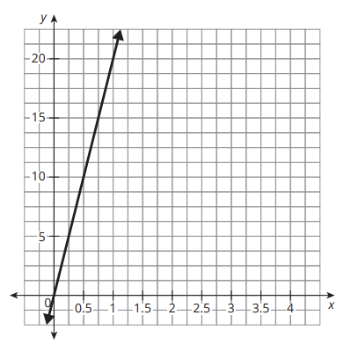
Comparing Tables and Graphs (1 of 5)
Large recycling centers pay out different amounts per ton of cardboard recycled. Travis County Recycling Center lists its payout amounts in a table, and Hays County uses a graph to advertise its payout amounts. The two centers’ payout amounts are close but not equal.
Travis County Recycling
Hays County Recycling
x | y
0.5 | $7.50
1 | $15
1.5 | $22.50
2 | $30
Ask Yourself…
How else can you represent this information?

Slide 18
Comparing Tables and Graphs (2 of 5)
Each representation shows a functional relationship between quantities. Label the quantities and their units in the table and on the graph.
Let w(x) represent the function for Travis County, and let j(x) represent the function for Hays County. Use >, <, or = to complete each statement.
a. w(0.5) ___ j(0.5) b. w(1) ____ j(1) c. w(3) ____ j(3)
Notes:
Questions to Support Discourse – Gathering:
How many pounds are in a ton?
Questions to Support Discourse – Probing:
How can you tell the independent quantity and dependent quantity from the scenario? Table? Graph?
How did you determine the values for j(0.5) and j(1)?
Did you need to calculate w(3) and j(3) to complete the statement? Explain your thinking.
How can you tell that each county consistently used the same payout rate regardless of the number of tons of cardboard?
How did you determine each county’s payout rate?
How could each county explain their payout rate as an equation? In a statement?
Which representation do you think citizens would prefer? Explain your thinking.

Slide 19
Comparing Tables and Graphs (3 of 5)
Compare the y-intercepts of each relationship. What does each y-intercept mean in terms of the relationship between the quantities?
Which recycling center would you choose? Provide evidence to justify your choice.
Ask Yourself…
Did you complete all the steps in the problem- solving model?
Notes:
Questions to Support Discourse – Gathering:
How many pounds are in a ton?
Questions to Support Discourse – Probing:
How can you tell the independent quantity and dependent quantity from the scenario? Table? Graph?
How did you determine the values for j(0.5) and j(1)?
Did you need to calculate w(3) and j(3) to complete the statement? Explain your thinking.
How can you tell that each county consistently used the same payout rate regardless of the number of tons of cardboard?
How did you determine each county’s payout rate?
How could each county explain their payout rate as an equation? In a statement?
Which representation do you think citizens would prefer? Explain your thinking.

Slide 20
Comparing Tables and Graphs (4 of 5)
Let’s revisit the Essential Question and summarize our learning from Activity 4.2!
Essential Question: How does each linear function representation compare with the others?
Notes:
Note: To close Day 1, have students reread the Essential Question and then read the Stamp the Learning summary aloud.
Activity 4.2 Summary:
Properties of functions represented in tables and graphs can be compared.

Slide 21
Comparing Tables and Graphs (5 of 5)
Notes:
Note: This slide is blank for optional use with displaying work.

Slide 22
Day 2
2
Notes:
Note: Total suggested pacing for Day 2 is 45 minutes.

Slide 23
Essential Question (2 of 2)
How does each linear function representation compare with
the others?
Notes:
Note: To begin Day 2, have a student read the Essential Question aloud.

Slide 24
Activity 4.3
4.3
10–15
Notes:
Note: Total time of 10-15 minutes allotted for Activity 4.3.

Slide 25
Comparing Equations and Tables (1 of 5)
Xavier and Joey are friends who live in different countries. When they chat online and talk about the weather, one of them always uses temperature in degrees Celsius while the other talks about temperature using degrees Fahrenheit.

Slide 26
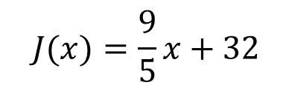
Comparing Equations and Tables (2 of 5)
Xavier uses an equation to convert Joey’s temperatures, and Joey looks at a table to convert Xavier’s temperatures. The equation and part of the table are shown.
Remember…
0°C = 32°F
Joey’s Table
Xavier’s Equation
10 | −12.2
30 | −1.1
50 | 10
75 | 23.9
$$J(x)=\frac{9}{5}x+32$$

Slide 27
Comparing Equations and Tables (3 of 5)
Identify quantities in the table and equation. Who is converting from °C to °F, and who is converting from °F to °C? Explain your reasoning.
Compare the given characteristics for each function in terms of the quantities.
a. slope b. y-intercept
Think About…
The units of the quantities are
very important.
Notes:
Questions to Support Discourse – Probing:
How could knowing that 0° F = 32° F help you make sense of the representations?
How did you determine the slope from Joey’s table?
How can you tell the y-intercept from each representation?
For this situation, do you think a table or equation is more helpful?
Questions to Support Discourse – Seeing Structure:
What is the relationship between the two rates of change? Why do you think this is the case?

Slide 28
Comparing Equations and Tables (4 of 5)
Let’s summarize our learning from Activity 4.3!
Notes:
Activity 4.3 Summary:
Properties of functions represented in tables and equations can be compared.

Slide 29
Comparing Equations and Tables (5 of 5)
Notes:
Note: This slide is blank for optional use with displaying work.

Slide 30
Activity 4.4
4.4
10–15
Notes:
Note: Total time of 10-15 minutes allotted for Activity 4.4.

Slide 31
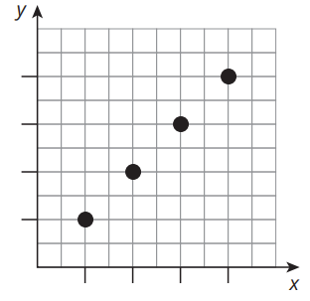
Comparing Descriptions and Graphs (1 of 4)
Lauren and Miguel both opened bank accounts at the same time. Miguel’s account balance is shown in the graph. He started with $0 and deposited the same amount each month. In the 4th month, he had $80 saved. Michelle opened her bank account on September 1st with $25 and continues to deposit $25 each month.
Miguel
Lauren
Lauren opened her bank account on September 1st with $25 and continues to deposit $25 each month.

Slide 32
Comparing Descriptions and Graphs (2 of 4)
Use what you know about Miguel’s account to determine the scale of each axis and interpret the origin on the graph. Explain your reasoning.
Compare the given characteristics for each function in terms of the quantities.
a. slope b. y-intercept
Ask Yourself…
How can you
use comparing graphs, tables, and descriptions in everyday life?
Notes:
Questions to Support Discourse – Probing:
How can you tell the independent quantity and dependent quantity from the scenario?
How did you use the given information to label and scale the axes?
What are the units for each slope?
Did you use the situation or graph to determine Miguel’s savings rate? Explain your method.
How did you identify Lauren’s savings rate?
Which representation is more straightforward in this context? Why?

Slide 33
Comparing Descriptions and Graphs (3 of 4)
Let’s summarize our learning from Activity 4.4!
Notes:
Activity 4.4 Summary:
Properties of functions represented in verbal descriptions and graphs can be compared.

Slide 34
Comparing Descriptions and Graphs (4 of 4)
Notes:
Note: This slide is blank for optional use with displaying work.

Slide 35
Talk the Talk
10–15
Notes:
Note: Total time of 10-15 minutes allotted for the Talk the Talk.

Slide 36
Function Maker Space (1 of 4)
Consider the table of values.
x | −10 | 10 | 20 | 25
y | 0 | 5 | 7.5 | 8.75
Create a situation to represent the table of values shown.
Write an equation that has a slope that is less steep than the relationship in the table.
Notes:
Questions to Support Discourse – Probing:
What information did you derive from the table to create your situation?
Does your situation model a linear relationship?
Does your situation model an increasing or decreasing function?
How does your situation encompass the entire domain?
Did you change the sign of the slope? Why or why not?
How did you determine the slope of the graphed line?
Questions to Support Discourse – Seeing Structure:
Can you tell whether a slope is increasing or decreasing more easily from a table or graph?
What is the advantage of calculating the slope of a line from a table?

Slide 37
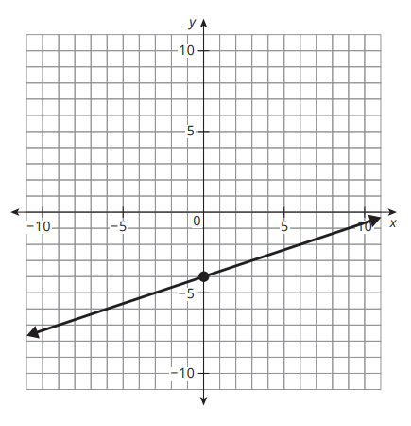
Function Maker Space (2 of 4)
How does the slope of the graph shown compare to the slope from the table of values and your equation?
What strategies did you use to create your linear functions and to compare the slopes?
Notes:
Questions to Support Discourse – Probing:
What information did you derive from the table to create your situation?
Does your situation model a linear relationship?
Does your situation model an increasing or decreasing function?
How does your situation encompass the entire domain?
Did you change the sign of the slope? Why or why not?
How did you determine the slope of the graphed line?
Questions to Support Discourse – Seeing Structure:
Can you tell whether a slope is increasing or decreasing more easily from a table or graph?
What is the advantage of calculating the slope of a line from a table?

Slide 38
Function Maker Space (3 of 4)
Let’s answer the Essential Question and summarize our learning from the Talk the Talk!
Essential Question: How does each linear function representation compare with the others?
Notes:
Note: To close Day 2, have students read and answer the Essential Question and then read the Stamp the Learning summary aloud.
Essential Question:
Sample answer: You can represent a linear function using an equation, a table, a graph, or a verbal description. You can understand characteristics of linear functions, such as slope, y-intercepts, and independent and dependent quantities from different representations of functions.
Talk the Talk Summary:
A variety of strategies can be used to compare linear functions presented in different representations.

Slide 39
Function Maker Space (4 of 4)
Notes:
Note: This slide is blank for optional use with displaying work.

Slide 40
Prepare
Notes:
How can you identify whether students are ready for new learning? ​
Depending on available time, you can assign the Prepare section of the Lesson Assignments as homework or as a warm-up to identify students' prior knowledge for the upcoming lesson's activities.

Slide 41
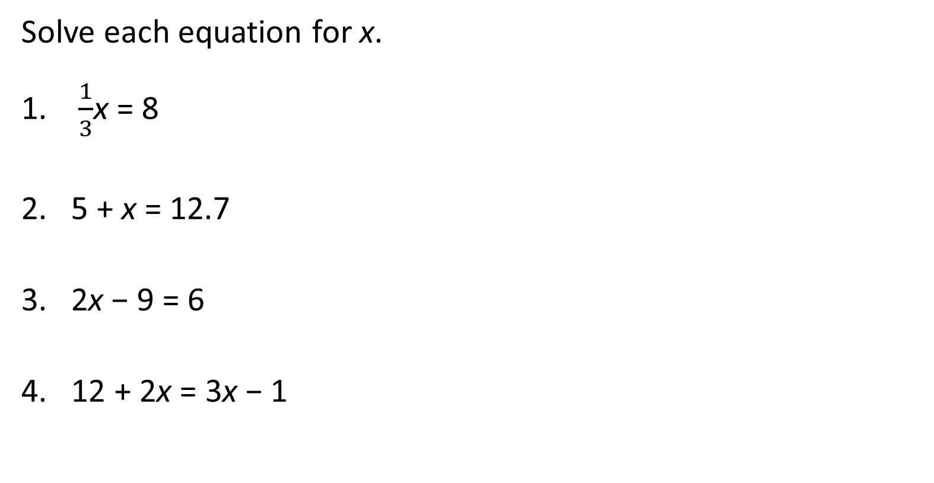
Prepare for Module 3 Topic 1 Lesson 1
Solve each equation for x.
$\frac{1}{3}$x = 8
5 + x = 12.7
2x − 9 = 6
12 + 2x = 3x − 1

Slide 42
Acknowledgment and Notice

Slide 43
BLMATH_AlgI_M2_T2_L4_DCS_ENG

